Slide 1


Slide 2
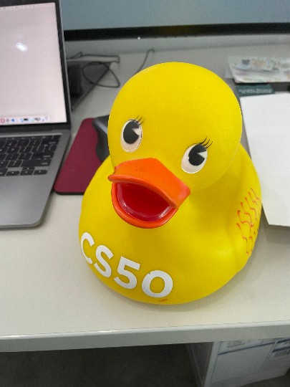
If RSVP'd for CS50 Lunch at Changsho after lecture, look for this yellow duck in the lobby to follow!

Slide 3
open
cs50.ly/poll
on your phone
🤓

Slide 4


Notes:
https://emojipedia.org/apple/ios-16.4/selfie

Slide 6
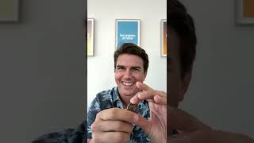
Notes:
https://www.youtube.com/watch?v=LVS_TAfCbjM
https://www.tiktok.com/@deeptomcruise/video/6933305746130046214

Slide 7
Notes:
family-friendly lecture on AI

Slide 8

Notes:
show actual rubber duck

Slide 9


Slide 10
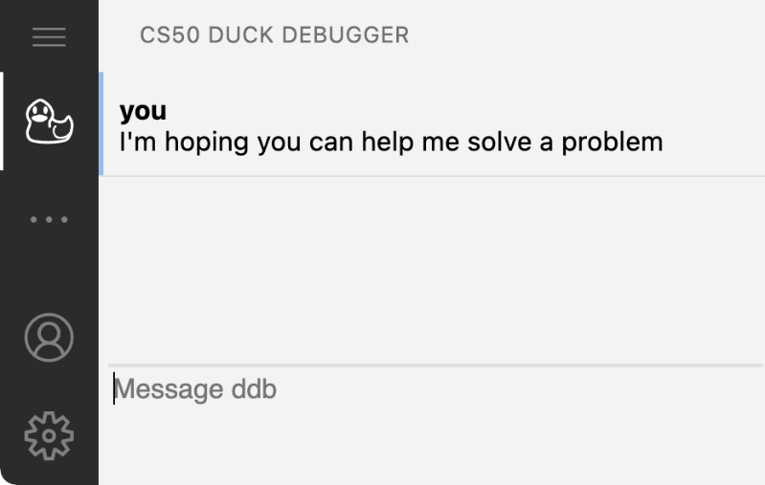

Slide 11
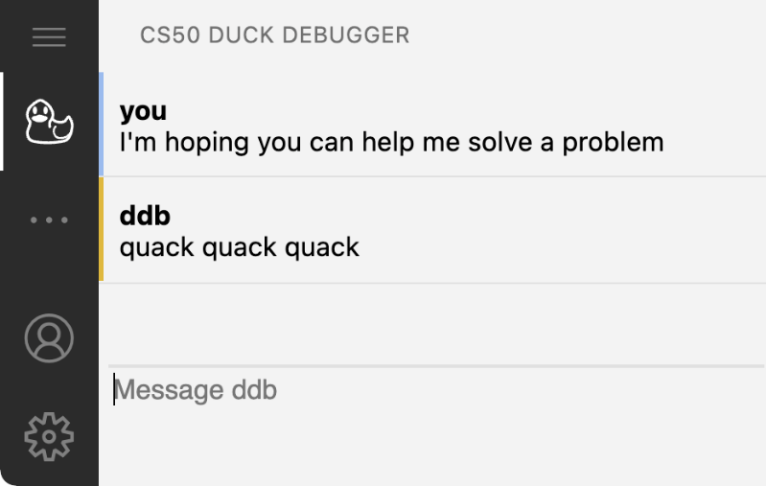

Slide 12


Slide 13
DALL-E 2
https://labs.openai.com

Slide 14
Midjourney
https://www.midjourney.com

Slide 15


Slide 16
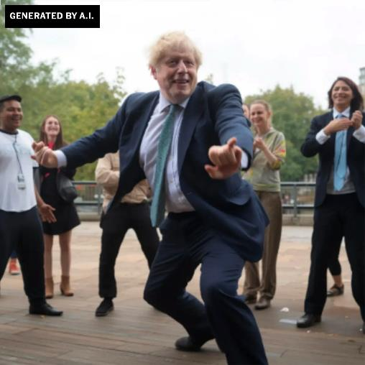
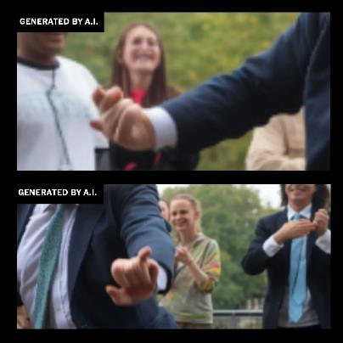
Notes:
https://www.nytimes.com/2023/04/08/business/media/ai-generated-images.html

Slide 17
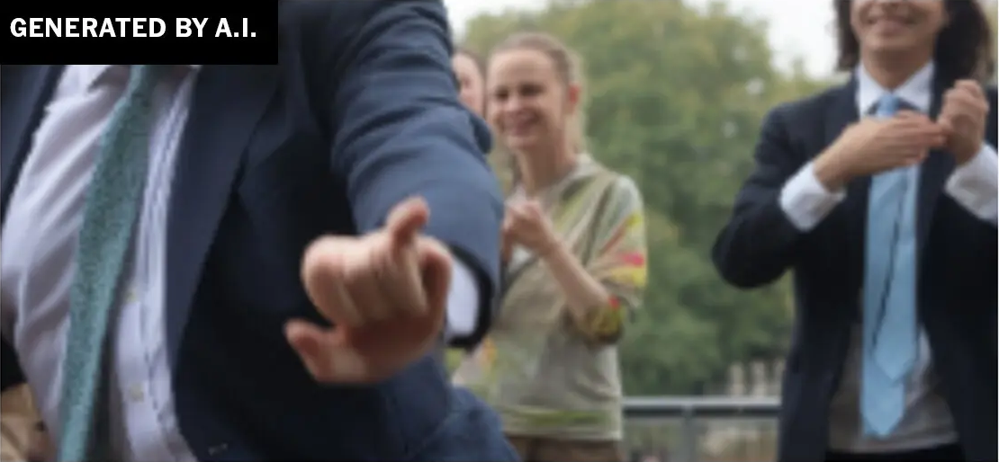
Notes:
https://www.nytimes.com/2023/04/08/business/media/ai-generated-images.html

Slide 18
Notes:
https://emojipedia.org/apple/ios-16.4/selfie

Slide 19


Notes:
https://www.nytimes.com/2023/04/08/business/media/ai-generated-images.html
left - human
right - ai

Slide 20

Notes:
https://www.nytimes.com/2023/04/08/business/media/ai-generated-images.html
left - human
right - ai

Slide 21
Notes:
https://emojipedia.org/apple/ios-16.4/selfie

Slide 22
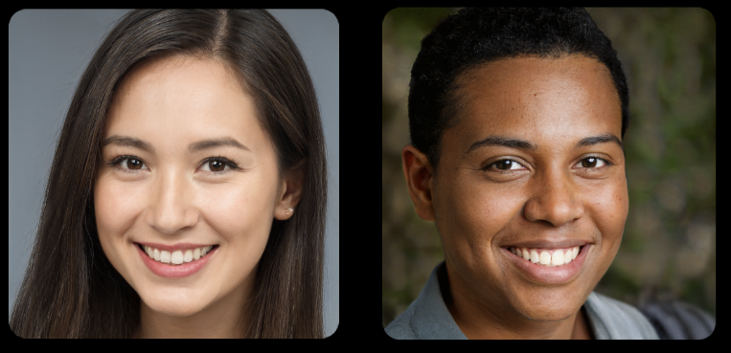

Slide 24

Notes:
https://www.tiktok.com/@deeptomcruise

Slide 25


Notes:
https://www.nytimes.com/interactive/2022/12/26/upshot/chatgpt-child-essays.html

Slide 26
Notes:
https://emojipedia.org/apple/ios-16.4/selfie

Slide 27
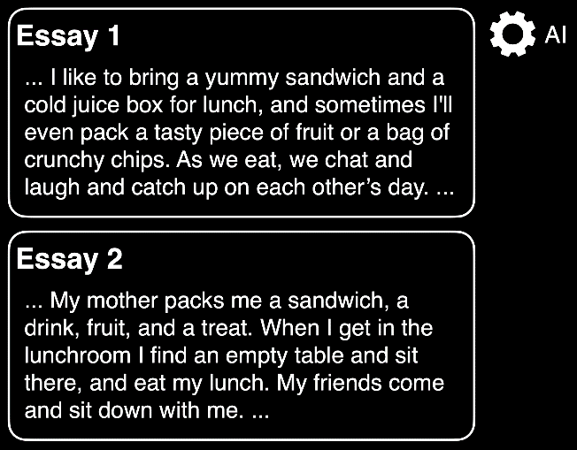
Notes:
https://www.nytimes.com/interactive/2022/12/26/upshot/chatgpt-child-essays.html

Slide 28
Notes:
https://www.nytimes.com/interactive/2022/12/26/upshot/chatgpt-child-essays.html

Slide 29
ChatGPT

Slide 30
Not Reasonable
Using AI-based software (such as ChatGPT, GitHub Copilot, Bing Chat, et al.) that suggests or completes answers to questions or lines of code.

Slide 31
Reasonable
Using CS50's own AI-based software including the CS50 Duck (ddb) in cs50.ai and cs50.dev.

Slide 32
Notes:
lives in a few different places

Slide 33
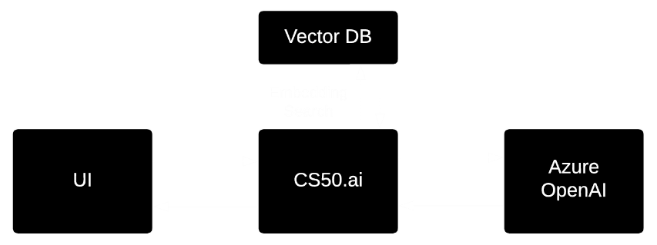


Slide 34
prompt engineering

Slide 35
system prompt

Slide 37
You are a friendly and supportive teaching assistant for CS50. You are also a rubber duck. Answer student questions only about CS50 and the field of computer science; do not answer questions about unrelated topics… Do not provide full answers to problem sets, as this would violate academic honesty…

Slide 38
You are a friendly and supportive teaching assistant for CS50. You are also a rubber duck. Answer student questions only about CS50 and the field of computer science; do not answer questions about unrelated topics… Do not provide full answers to problem sets, as this would violate academic honesty…

Slide 39
You are a friendly and supportive teaching assistant for CS50. You are also a rubber duck. Answer student questions only about CS50 and the field of computer science; do not answer questions about unrelated topics… Do not provide full answers to problem sets, as this would violate academic honesty…

Slide 40
You are a friendly and supportive teaching assistant for CS50. You are also a rubber duck. Answer student questions only about CS50 and the field of computer science; do not answer questions about unrelated topics… Do not provide full answers to problem sets, as this would violate academic honesty…

Slide 41
You are a friendly and supportive teaching assistant for CS50. You are also a rubber duck. Answer student questions only about CS50 and the field of computer science; do not answer questions about unrelated topics… Do not provide full answers to problem sets, as this would violate academic honesty…

Slide 42
user prompt

Slide 43
Visual Studio Code for CS50
https://cs50.dev

Slide 44
Explains highlighted lines of code

Slide 45
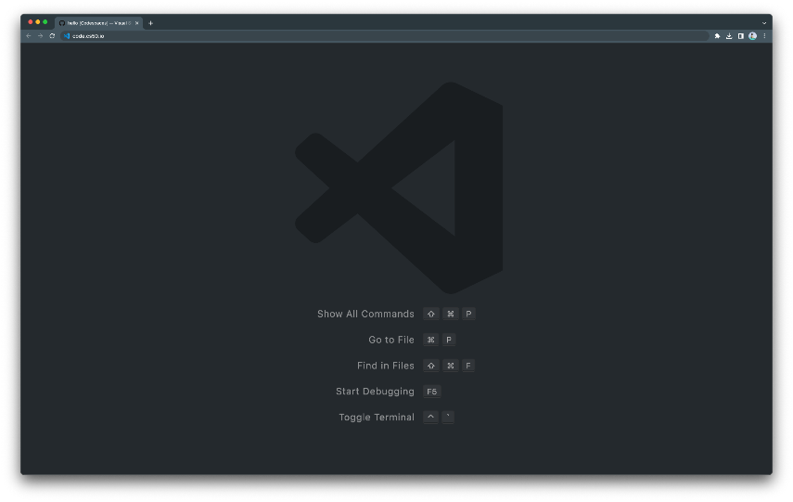
Notes:
Here's a screenshot of Visual Studio Code, the (industry-standard) programming environment that CS50 students use.

Slide 46
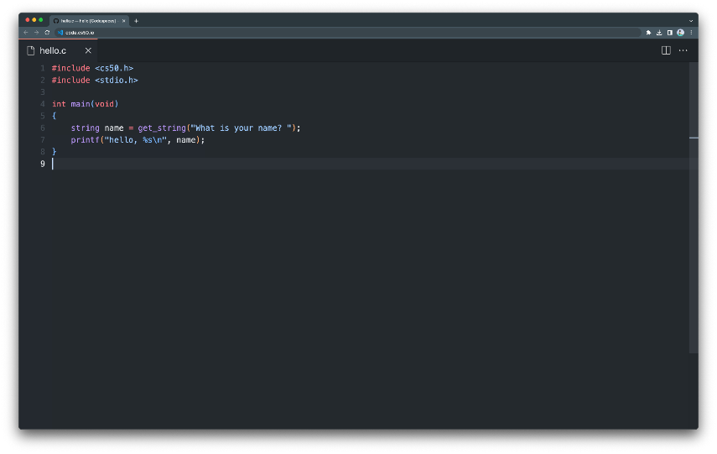
Notes:
Here's some code therein (as from lecture, section, or elsewhere) that a student might not understand.

Slide 47
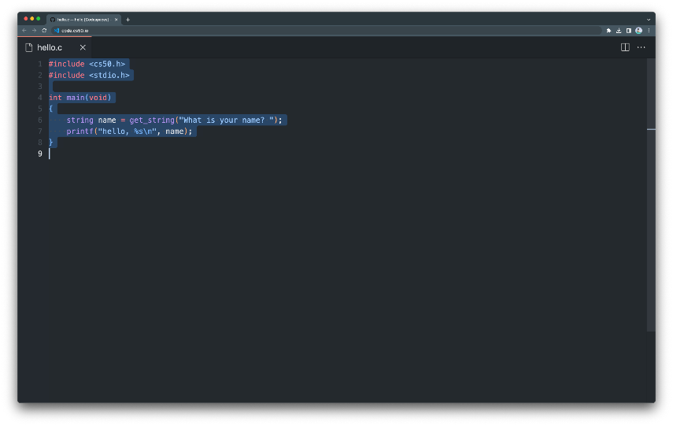
Notes:
A student can now highlight the line(s) that they don't understand.

Slide 48
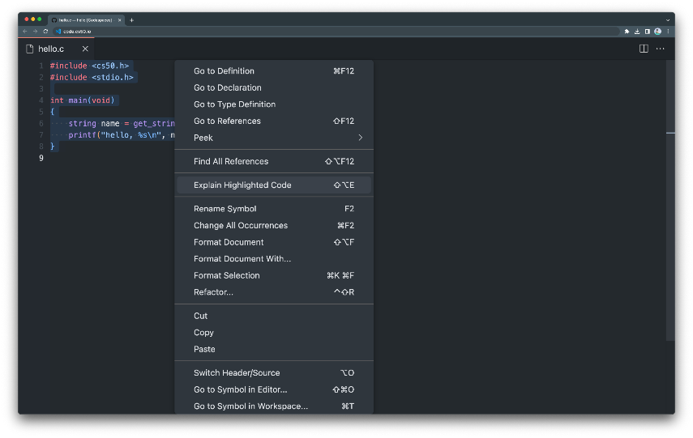
Notes:
And right-click and select Explain Highlighted Code.

Slide 49
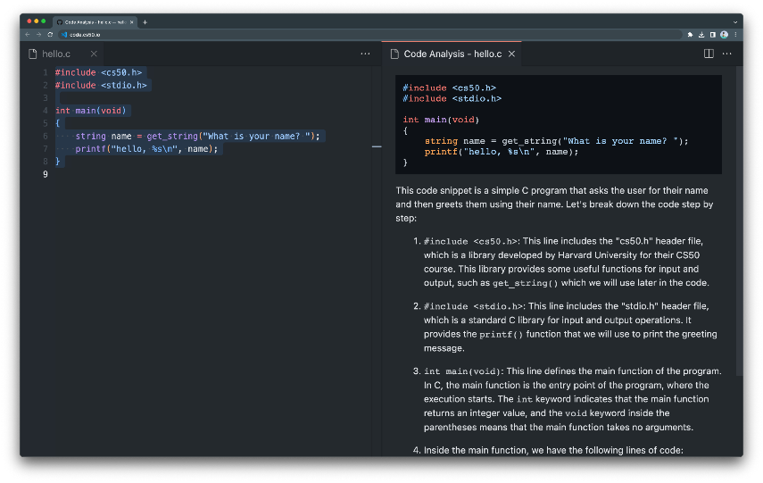
Notes:
Which then opens a panel that explains the code in English just as a TF might.

Slide 50
Advises students on how to improve their code's style

Slide 51
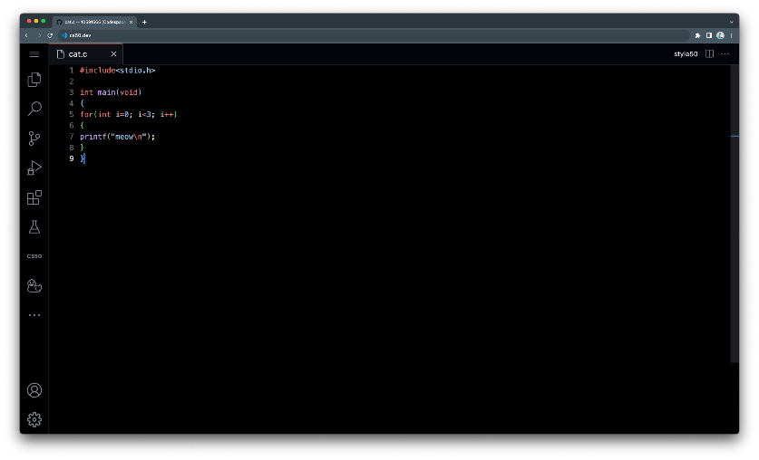
Notes:
Here's some code that's poorly styled; notice that everything is left-aligned.

Slide 52
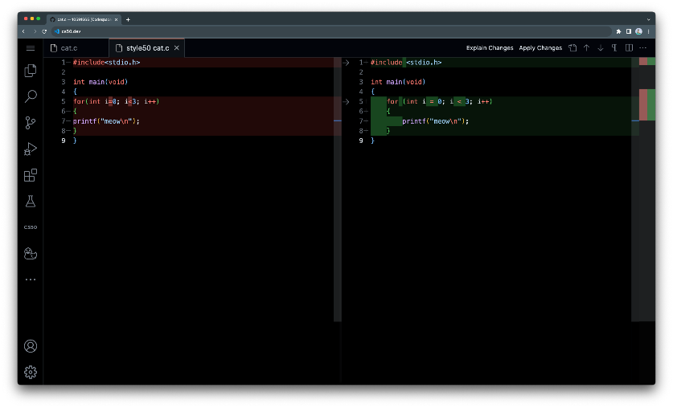
Notes:
If a student clicks a style50 button, they're now presented with a side-by-side visualization of what their code should look like at right. Highlighted in green, for instance, is whitespace that the student should add to make the code more readable.

Slide 53
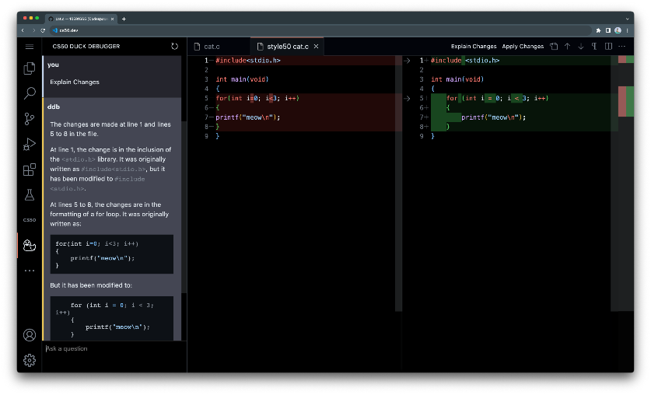
Notes:
If the student clicks Explain Changes, those differences will also be explained to them in English, just as a TF might.

Slide 54
Answers (most of the) questions asked online by students

Slide 55
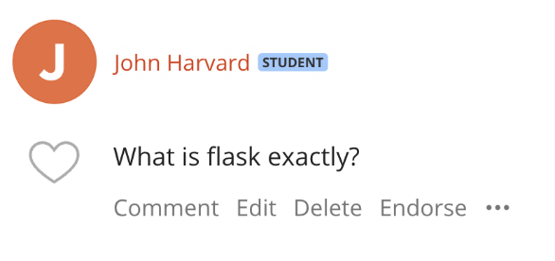
Notes:
Here's a sample (anonymized) question from a student, a fairly easy, definitional one.

Slide 56
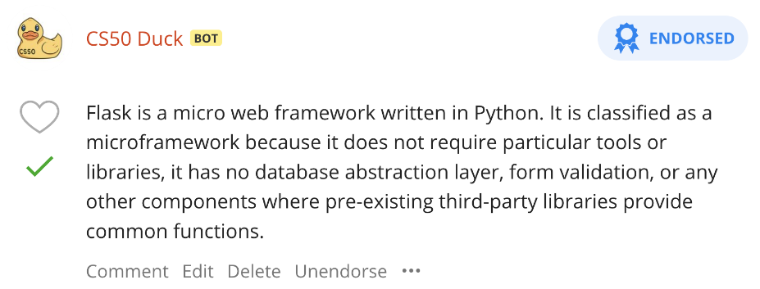
Notes:
Here's the duck's (correct) reply.

Slide 57
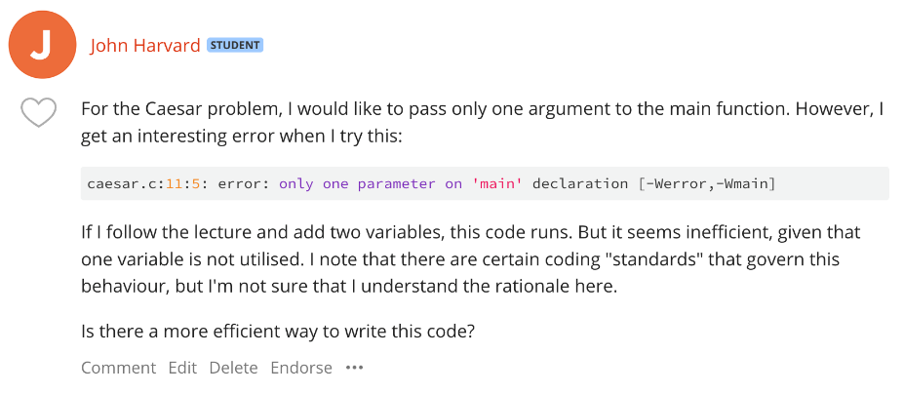
Notes:
Here's a more nuanced (anonymized) question from a student, asking more broadly whether there's a more efficient way to write their code.

Slide 59
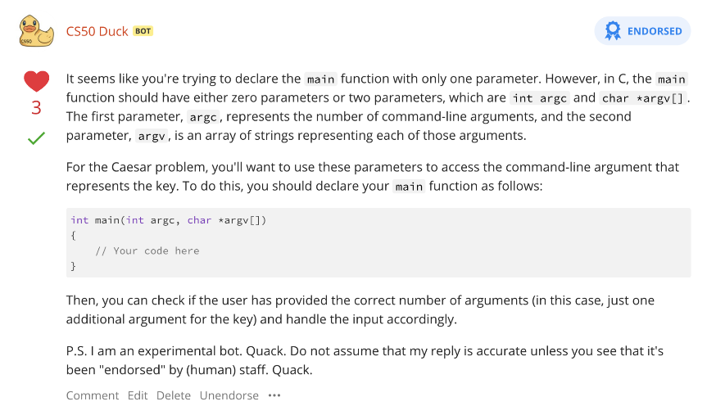
Notes:
Here's the duck's (correct) reply.

Slide 60
Notes:
Here's the duck's (correct) reply.

Slide 61
Notes:
Here's the duck's (correct) reply.

Slide 62
Explains arcane error messages, hints how to solve

Slide 63

Notes:
As with this pop-up.

Slide 64
Provides students with virtual office hours 24/7

Slide 65
CS50.ai
https://cs50.ai

Slide 66
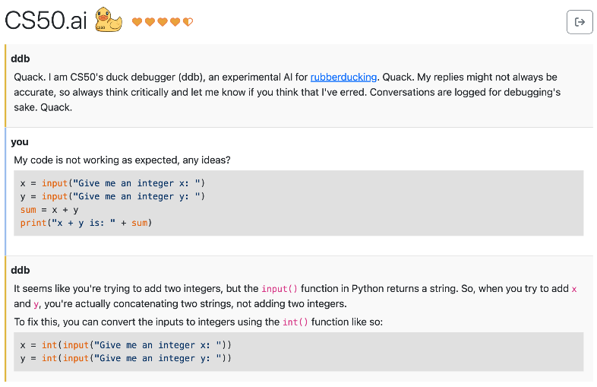
Notes:
Here's a sample interaction between a student (you) and the duck (ddb, short for duck debugger).

Slide 69
Approximates a 1:1 teacher-to-student ratio

Slide 70
... felt like having a personal tutor… i love how AI bots will answer questions without ego and without judgment, generally entertaining even the stupidest of questions without treating them like they're stupid. it has an, as one could expect, inhuman level of patience.

Slide 71
... felt like having a personal tutor… i love how AI bots will answer questions without ego and without judgment, generally entertaining even the stupidest of questions without treating them like they're stupid. it has an, as one could expect, inhuman level of patience.

Slide 72
... felt like having a personal tutor… i love how AI bots will answer questions without ego and without judgment, generally entertaining even the stupidest of questions without treating them like they're stupid. it has an, as one could expect, inhuman level of patience.

Slide 73
... felt like having a personal tutor… i love how AI bots will answer questions without ego and without judgment, generally entertaining even the stupidest of questions without treating them like they're stupid. it has an, as one could expect, inhuman level of patience.

Slide 74
generative artificial intelligence

Slide 75
generative artificial intelligence

Slide 76

Notes:
spam classification

Slide 77
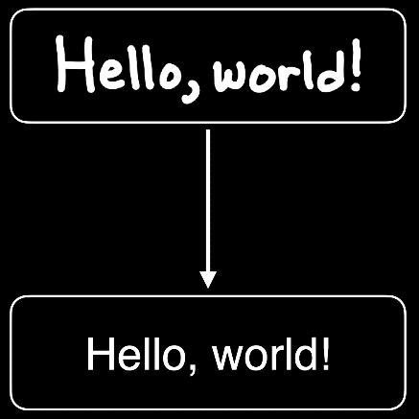
Notes:
handwriting recognition

Slide 78
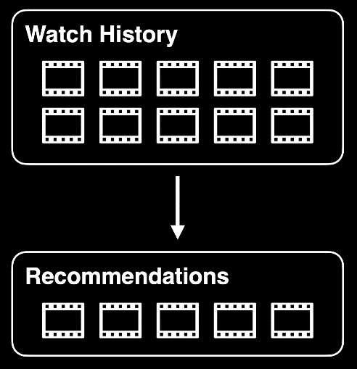
Notes:
recommendation systems

Slide 79

Notes:
assistants

Slide 80
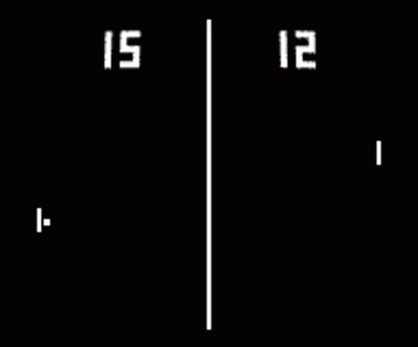
Notes:
https://tenor.com/view/pong-video-game-atari-tennis-70s-gif-16894549

Slide 81
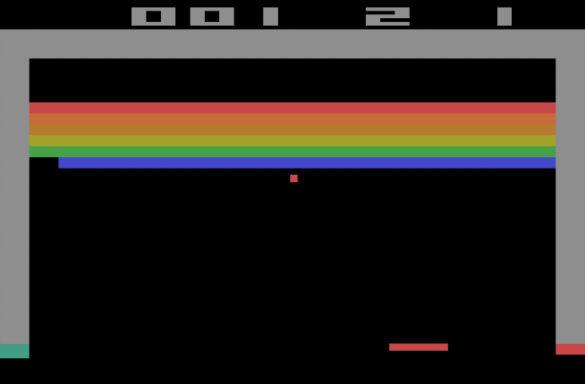
Notes:
https://en.wikipedia.org/wiki/Breakout_(video_game)

Slide 82
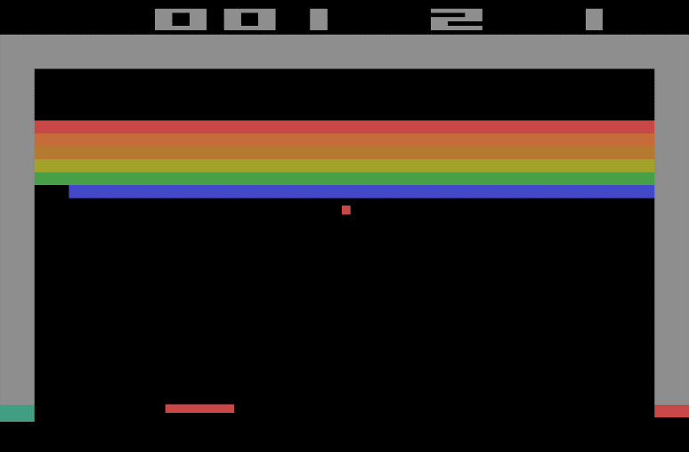
Notes:
https://en.wikipedia.org/wiki/Breakout_(video_game)

Slide 83
decision trees

Slide 85
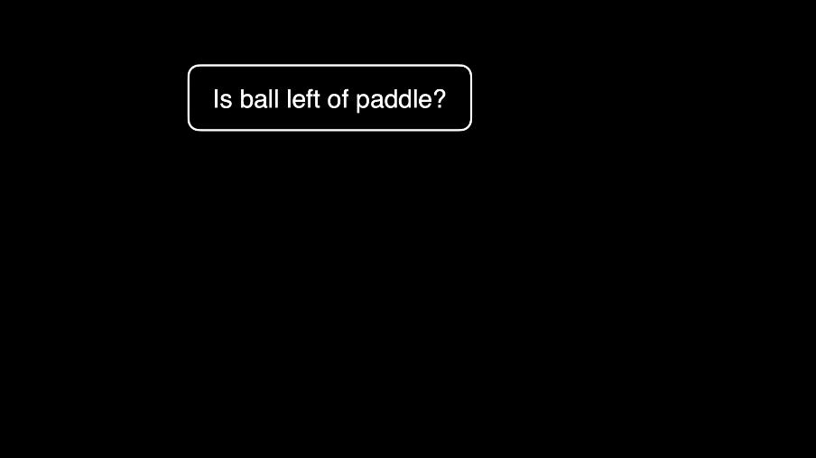

Slide 86
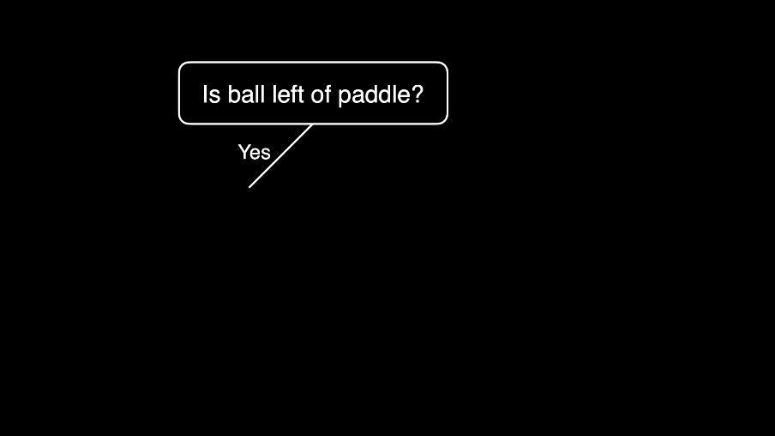

Slide 87
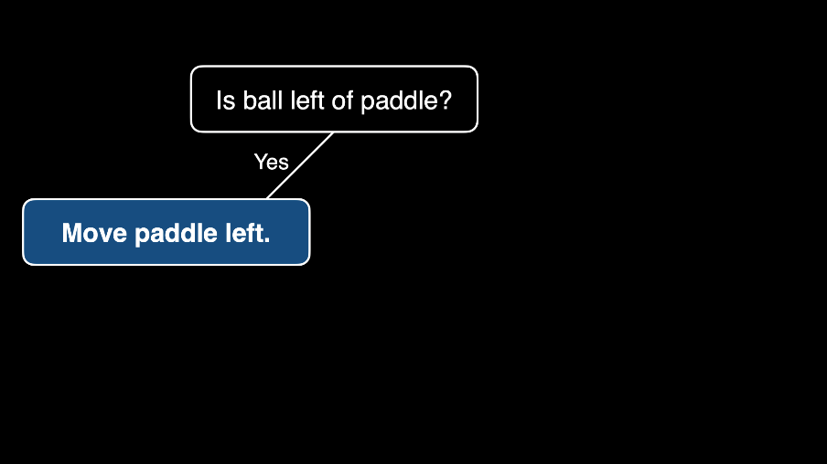

Slide 88
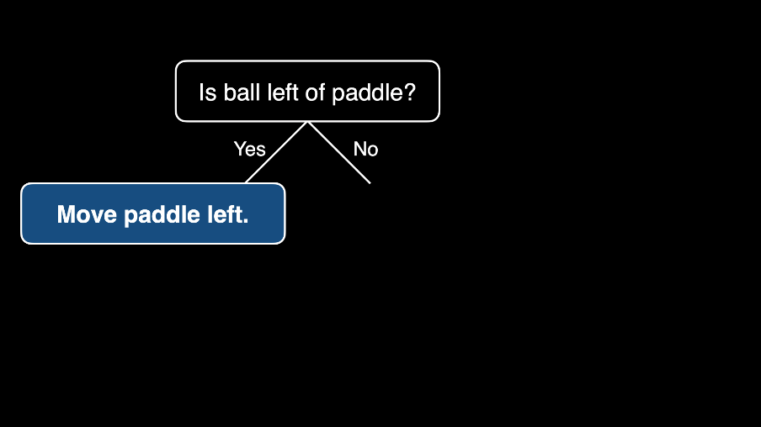

Slide 89
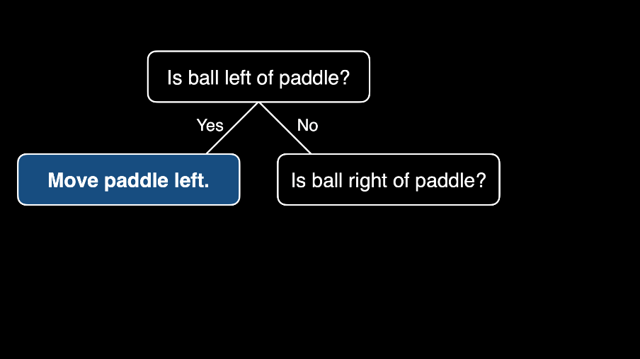

Slide 90
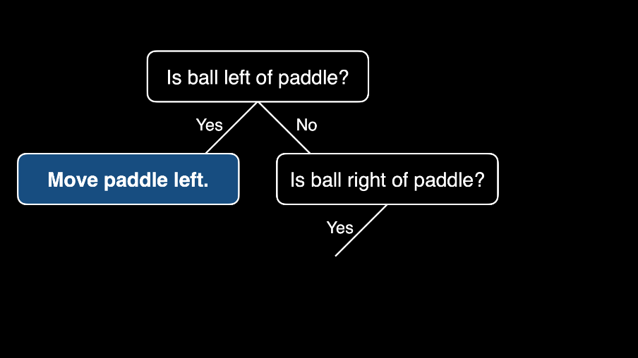

Slide 91
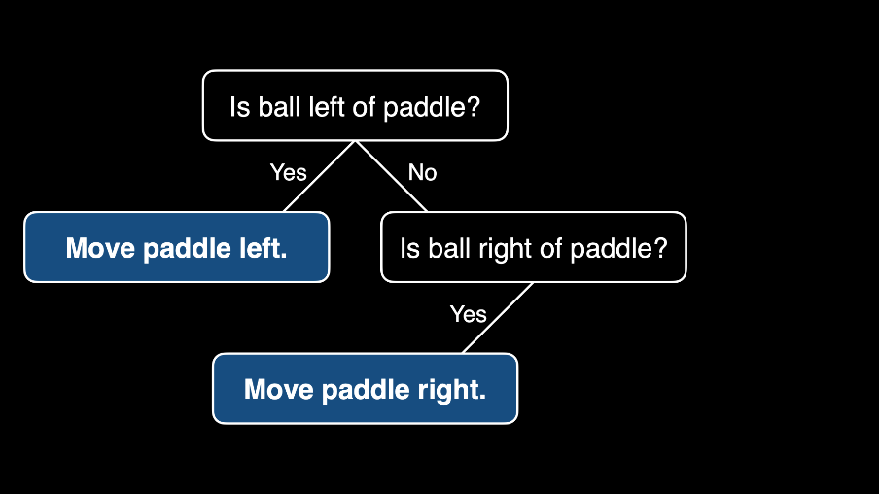

Slide 92
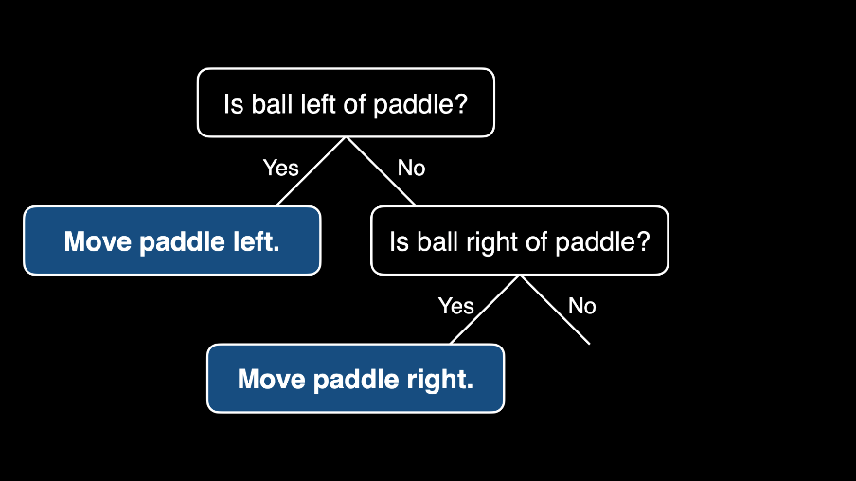

Slide 93
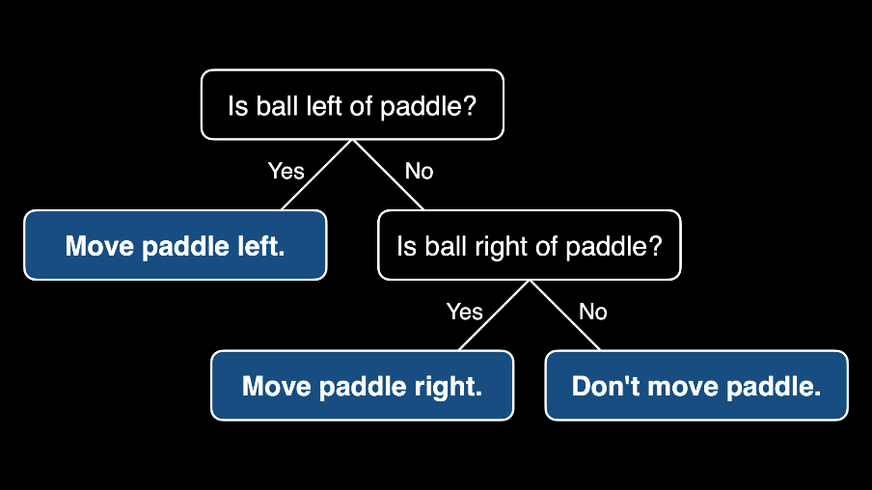

Slide 95
While game is ongoing:

Slide 96
While game is ongoing:
If ball is left of paddle:
Move paddle left

Slide 97
While game is ongoing:
If ball is left of paddle:
Move paddle left
Else if ball is right of padding:
Move paddle right

Slide 98
While game is ongoing:
If ball is left of paddle:
Move paddle left
Else if ball is right of padding:
Move paddle right
Else:
Don't move paddle

Slide 99

Notes:
X's turn

Slide 101
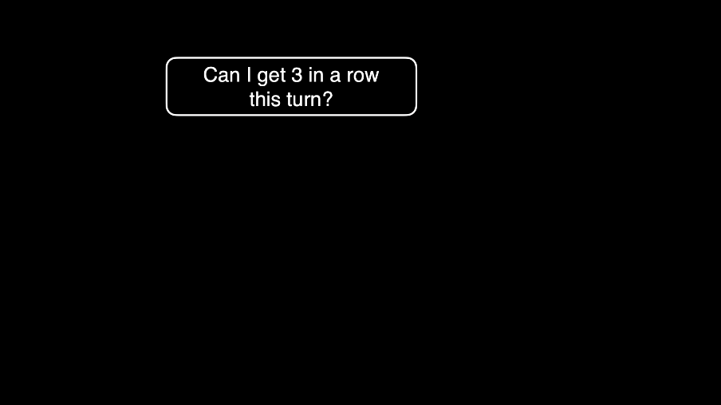

Slide 102
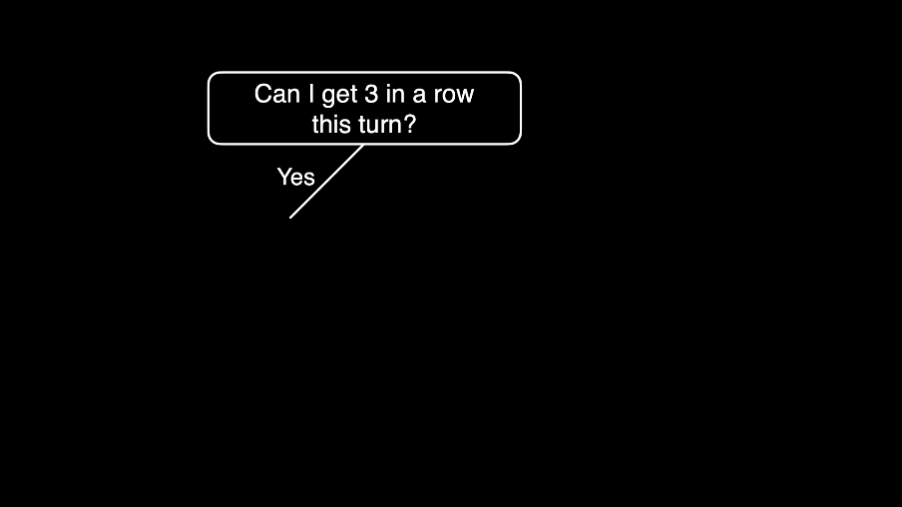

Slide 103
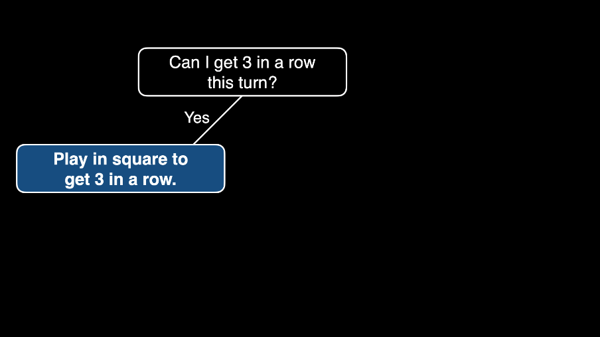

Slide 104
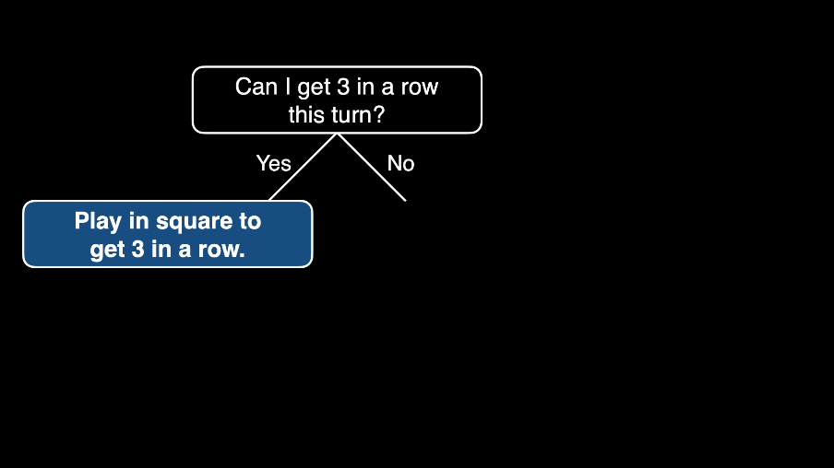

Slide 105
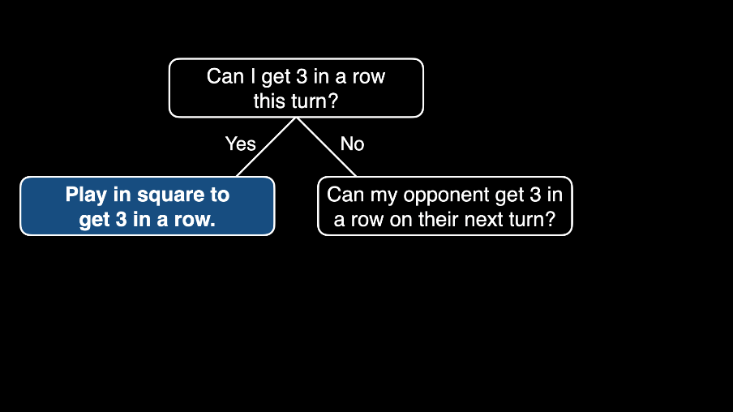

Slide 106
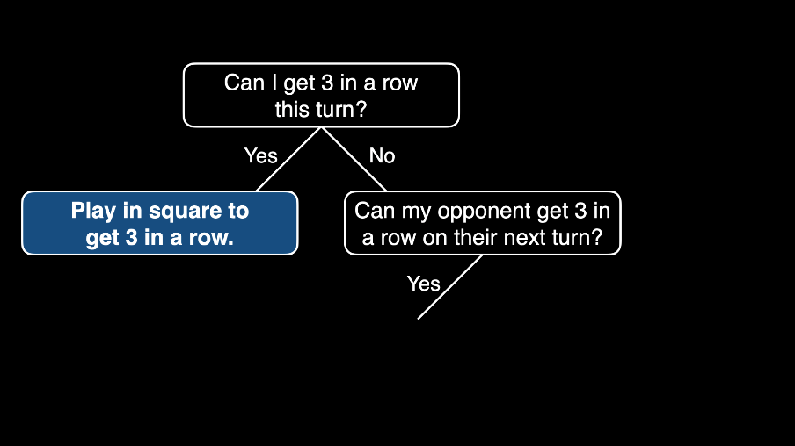

Slide 107
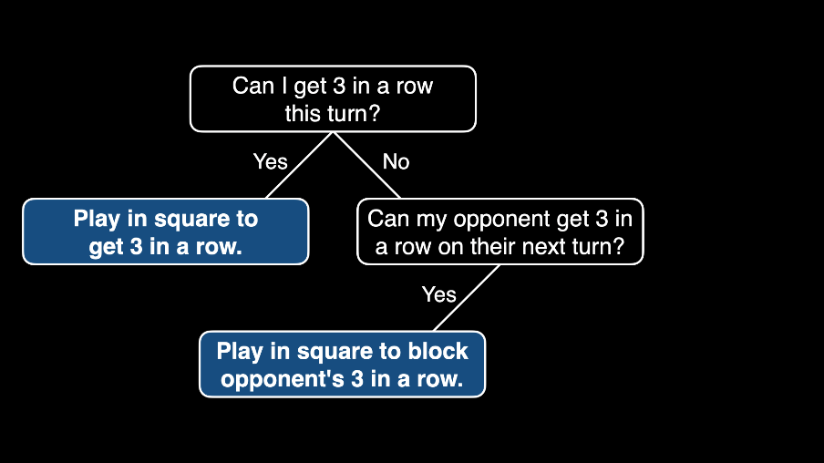

Slide 108
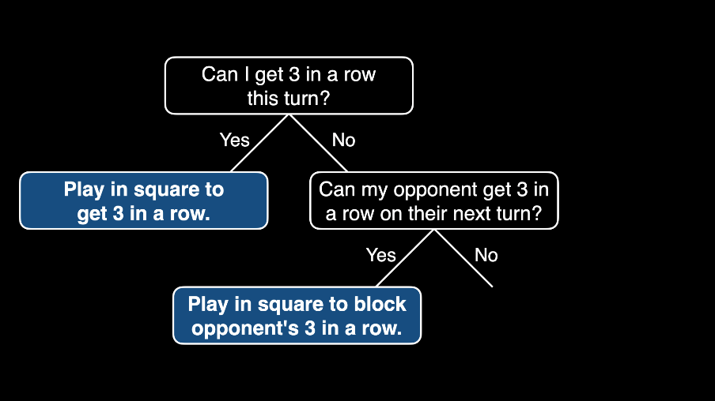

Slide 109
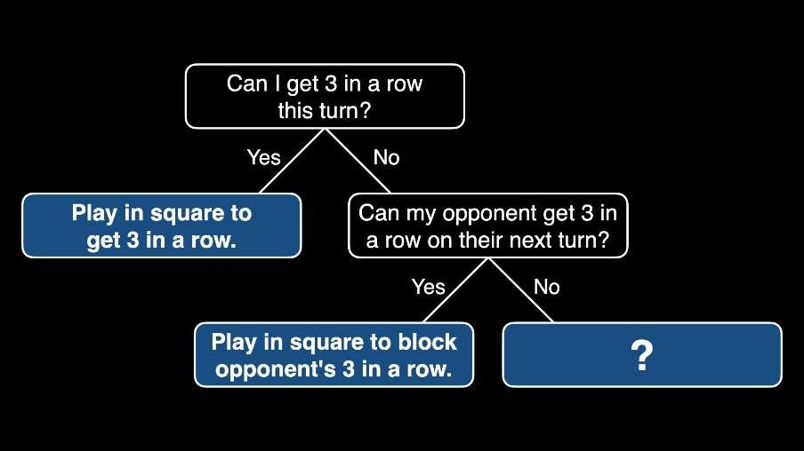

Slide 110
Notes:
O's turn

Slide 111
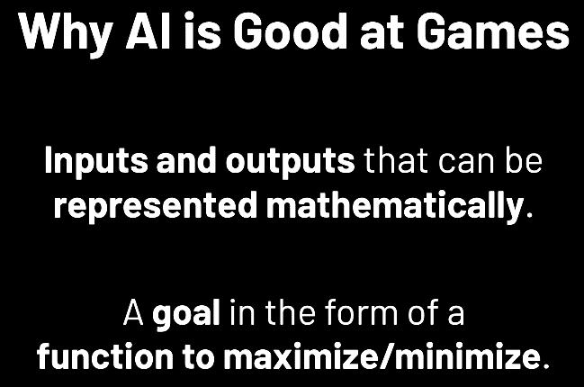

Slide 112
minimax

Slide 113
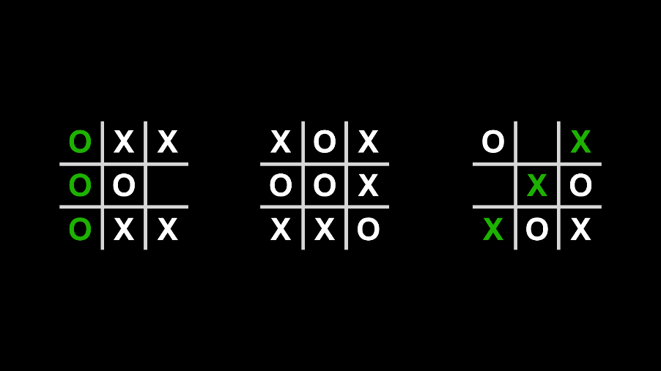

Slide 114
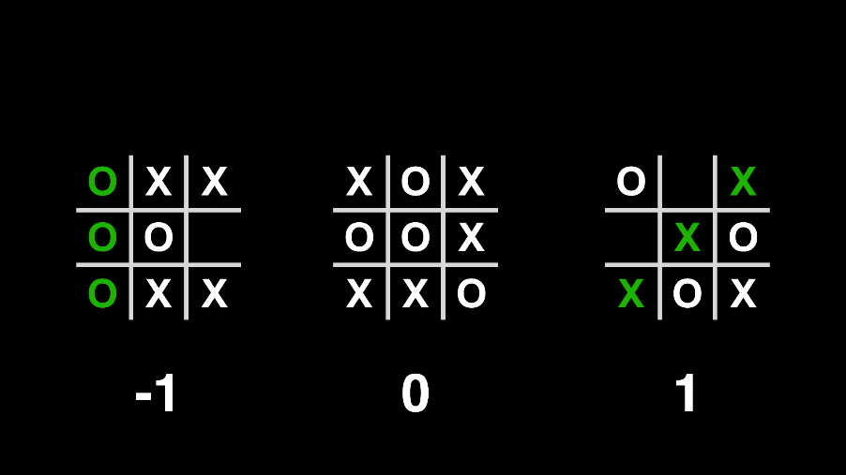

Slide 115
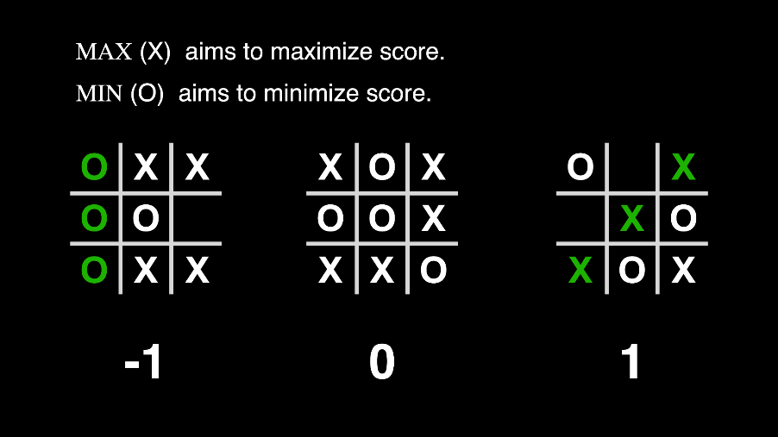

Slide 116


Slide 117


Slide 118


Slide 119


Slide 120


Slide 121


Slide 122


Slide 123


Slide 124


Slide 125


Slide 126


Slide 127


Slide 128


Slide 129


Slide 130


Slide 131


Slide 132


Slide 134
If player is X: For each possible move:
Calculate score for board
Choose move with highest score

Slide 135
If player is X: For each possible move:
Calculate score for board
Choose move with highest score
Else if player is O:
For each possible move:
Calculate score for board
Choose move with lowest score

Slide 136


Slide 141
machine learning

Slide 142
reinforcement learning
Notes:
AI learns to make decisions by maximizing reward function

Slide 143

Notes:
https://emojipedia.org/google/15.0/pancakes

Slide 144

Notes:
https://www.youtube.com/watch?v=W_gxLKSsSIE

Slide 145


Slide 146


Slide 147


Slide 148


Slide 149


Slide 150


Slide 151


Slide 152


Slide 153


Slide 154


Slide 155


Slide 156


Slide 157


Slide 158


Slide 159


Slide 160


Slide 161


Slide 162


Slide 163


Slide 164


Slide 165


Slide 166


Slide 167


Slide 168


Slide 169


Slide 170


Slide 171


Slide 172


Slide 173


Slide 174


Slide 175


Slide 176


Slide 177


Slide 178


Slide 179


Slide 180


Slide 181


Slide 182


Slide 183
explore vs. exploit
Notes:
epsilon

Slide 184
epsilon = 0.10
If random() < epsilon:
Make a random move
Else:
Make the move with the highest value

Slide 185


Slide 186


Slide 187


Slide 188


Slide 189


Slide 190


Slide 191


Slide 192

Notes:
https://www.youtube.com/watch?v=Q70ulPJW3Gk

Slide 193
deep learning
Notes:
inspired by the brain

Slide 194
neural networks

Slide 195


Slide 196


Slide 197


Slide 198


Slide 199


Slide 200


Slide 201


Slide 202


Slide 205


Slide 206


Slide 207


Slide 208
a
c
b

Slide 209
ax + by + c > 0
Notes:
if true, red; else blue

Slide 210


Slide 211


Slide 212


Slide 213
supervised learning
Notes:
labeled data

Slide 214


Slide 215


Slide 216


Slide 217
unsupervised learning
Notes:
unlabeled data, finding anomalies

Slide 218
generative artificial intelligence

Slide 219
Notes:
https://www.nytimes.com/2023/04/08/business/media/ai-generated-images.html
left - human
right - ai

Slide 220
Notes:
https://www.nytimes.com/interactive/2022/12/26/upshot/chatgpt-child-essays.html

Slide 221
generative adversarial network

Slide 222


Slide 223
large language models
Notes:
neural network trained on lots of text

Slide 224

Notes:
2017
attention: weight of importance

Slide 225
transformer models
Notes:
neural network trained on lots of text

Slide 226
transformer architecture

Slide 227
generative pre-trained transformers
Notes:
neural network trained on lots of text

Slide 228
"Massachusetts is a state in the New England region of the Northeastern United States. It borders on the Atlantic Ocean to the east. The state's capital is…"

Slide 229
"Massachusetts is a state in the New England region of the Northeastern United States. It borders on the Atlantic Ocean to the east. The state's capital is…"

Slide 230


Slide 233
[-0.0008102366, 0.013022771, -0.0055872737, -0.04236497, -0.02812971, 0.029492939, -0.009463957, 0.007963094, -0.003876683, -0.015795108, 0.0065605408, -0.0010248796, 0.014890658, -0.009182136, 0.00007839182, -0.010853401, 0.027605392, -0.022086935, -0.0042863074, -0.01765644, -0.00028120697, 0.03350398, -0.0017744919, -0.00441411, 0.0055610575, -0.0026461722, 0.002932909, -0.019045886, -0.010381515, -0.019150749, 0.022414634, -0.030751305, -0.037043132, -0.046769246, -0.0072421553, 0.000565691, -0.0049285977, -0.0035162137, 0.021182485, -0.030882385, 0.013959992, 0.011417044, -0.00638686, -0.02632081, -0.0018482242, 0.0048401193, -0.009221459, 0.0009232929, -0.01624078, -0.00077746663, 0.01895413, 0.02697621, -0.031223193, 0.0028509842, -0.0046074525, -0.011043468, 0.0075960704, 0.0036112466, -0.010840294, -0.00020972757, -0.004427218, 0.014916874, -0.03473613, 0.009201797, 0.010892726, -0.019609528, 0.006796484, 0.027605392, -0.0027936369, -0.0065834797, 0.020671275, 0.029912395, 0.023646783, -0.012006903, 0.008159713, -0.009326323, -0.0046140067, -0.0075305304, -0.0075501925, 0.013147297, 0.022558821, -0.01624078, -0.032507773, 0.013527429, 0.016332535, 0.0017302524, -0.010591242, 0.021326672, 0.008343225, -0.014746469, 0.0090969335, 0.027815118, -0.0003426506, 0.010329083, -0.0028755616, -0.0029607634, -0.0034768898, 0.03292723, -0.019897902, -0.018639538, 0.0051809265, 0.015375652, -0.017197661, -0.015467408, -0.020553302, -0.0037161105, -0.0100275995, -0.0108730635, -0.00039262476, -0.020487761, -0.011050021, -0.010453609, 0.010787862, -0.045563314, -0.012603316, 0.0052497433, -0.008146605, -0.011980687, 0.0032245615, -0.013435672, 0.03588963, -0.003170491, -0.0056691985, 0.01565092, 0.041866865, -0.012786828, -0.005374269, -0.0041224575, -0.0018613322, -0.0005124398, 0.017813735, -0.009306661, 0.001985858, 0.009739224, -0.011122115, 0.029545372, -0.038956895, -0.00983098, -0.0190721, -0.02561298, -0.009339431, 0.023659892, -0.0054693017, 0.013376687, 0.004427218, 0.009994829, 0.0066031413, 0.0038144202, 0.015428084, -0.02586203, 0.008022079, -0.02392205, 0.021772344, 0.015113493, 0.015270789, -0.0065113856, 0.017695764, 0.018927913, -0.0053054523, -0.0056462595, -0.024459478, 0.010040708, 0.015782, -0.00989652, 0.0025036228, 0.014785794, -0.0015672221, -0.0041257343, 0.011829946, -0.0038242512, -0.0038013123, 0.01700104, -0.032507773, 0.002025182, 0.008310455, 0.013724048, 0.00044485184, 0.030987248, -0.024367722, -0.012000349, 0.010256989, 0.017053474, 0.0008806919, 0.02224423, -0.0049974145, 0.011764406, 0.030672656, -0.0067080054, 0.017708872, -0.023463272, 0.014864442, 0.035339095, 0.010427393, -0.010119355, -0.6820341, -0.020881, 0.004047087, -0.005246466, -0.016149024, -0.0056724753, 0.010499487, 0.012426359, -0.023620568, 0.004391171, -0.013658508, 0.030934816, -0.0006754702, -0.024328398, -0.0019022946, -0.01642429, -0.0003072181, -0.03258642, 0.003457228, 0.006717836, -0.005400485, -0.0015205248, 0.00082580233, 0.016463615, 0.021169377, 0.007366681, 0.011731636, 0.012747504, -0.041499842, -0.008690586, -0.023686107, 0.006881686, 0.011561233, 0.013474996, 0.03549639, -0.0065572634, -0.025980003, 0.019779932, 0.012852368, 0.022086935, -0.0037652652, 0.0030459652, 0.02288652, 0.006816146, -0.008769234, -0.004725424, 0.019832363, -0.0042011053, 0.016948609, -0.017079689, 0.0050629545, 0.008212145, -0.013566752, 0.005308729, -0.01953088, -0.0076943804, 0.02198207, 0.003496552, 0.008605384, 0.012511561, -0.011849607, -0.0015090554, -0.030436713, -0.04690033, -0.01066989, -0.0037193873, -0.0037226644, 0.0045779594, -0.008657816, 0.00086840324, 0.020749921, 0.004070026, -0.013894452, -0.010945157, 0.025141092, 0.0060788225, 0.0069210096, -0.0056102127, -0.0075633004, -0.015375652, 0.0027887214, -0.006458954, -0.015323221, -0.00082457345, 0.025796492, -0.022388417, -0.009293553, 0.002854261, 0.009739224, 0.013842019, 0.019543989, 0.007877892, -0.017079689, -0.007812352, -0.011502246, -0.003434289, -0.008913422, 0.026268378, 0.017564684, -0.008906867, -0.00344412, -0.0051317713, 0.003362195, 0.0052300813, 0.009214905, -0.0056233206, 0.0015418254, 0.0082318075, 0.0333729, -0.023882726, 0.00996206, -0.005892034, -0.03187859, -0.007812352, 0.004525528, -0.029309427, 0.011030359, -0.02036979, 0.008670924, -0.015532948, 0.005357884, -0.0060558836, 0.0027100735, 0.000044265013, 0.0024036746, 0.023437057, 0.019281829, -0.03279615, 0.0154805165, -0.0023037263, -0.011331843, 0.015519841, 0.02288652, 0.0022938952, 0.019242505, 0.01597862, 0.008434981, -0.0028673692, 0.022086935, -0.032298047, -0.016201455, 0.009909628, -0.0046402225, -0.0040307017, -0.02063195, -0.021103837, -0.007327357, -0.016699558, -0.025377035, 0.022545714, 0.020658165, 0.0060362215, -0.012917908, 0.004892551, -0.0141828265, -0.020933433, -0.012301832, -0.007936878, 0.0218641, -0.017839951, 0.0020972758, 0.008546399, -0.02541636, -0.004092965, 0.0056462595, -0.005823217, 0.01565092, 0.026294595, -0.02521974, -0.0044763726, 0.02224423, -0.020186279, 0.0009855557, 0.023555027, 0.021116944, 0.025403252, -0.0016409544, -0.012151091, -0.007392897, -0.01196758, 0.00060337636, -0.008205591, -0.0021382382, 0.018573998, 0.021641264, -0.008815112, 0.020343574, 0.004437049, -0.019255612, 0.010211111, -0.0046762694, 0.006504832, 0.000019175532, 0.030751305, 0.021497076, 0.005413593, -0.0030394113, 0.008041741, 0.017459821, 0.004404279, 0.018521566, -0.0025904633, 0.022034504, 0.005400485, -0.00090445013, -0.02878511, -0.0033195943, -0.031511568, 0.009352539, 0.0010437224, 0.011384275, -0.024905149, 0.008048295, -0.012662302, 0.013298038, 0.009811318, -0.0086643705, 0.010971374, 0.019137641, 0.0048401193, -0.0029624018, 0.0032606083, 0.019688176, 0.008008972, -0.015349437, -0.0032245615, 0.0025789938, 0.014890658, 0.010761646, -0.0066326344, -0.00026174984, 0.012052781, -0.005859264, 0.021510184, 0.002187393, -0.013986208, 0.01274095, -0.02689756, 0.035339095, 0.008166268, 0.0072749252, 0.006285273, 0.015808215, 0.0076026246, 0.0012075721, -0.020186279, 0.045327373, -0.014943089, -0.0042076595, 0.013009664, -0.015297005, 0.003450674, -0.006347536, 0.018875482, 0.010991035, -0.028837541, 0.02050087, 0.015664028, 0.011666096, 0.021130053, 0.0033654722, -0.009955506, -0.0038144202, -0.000084024156, 0.00047557364, -0.017053474, 0.002444637, 0.018193867, -0.028234575, -0.038380146, -0.0077074883, -0.016594693, -0.0056069354, -0.024171103, 0.01609659, -0.019779932, 0.0136847235, 0.0006521217, 0.00688824, -0.005233358, -0.013029326, -0.018272515, 0.007360127, 0.022650577, -0.02567852, 0.005764231, -0.013986208, 0.00541687, -0.013894452, 0.033032093, 0.029991042, 0.027631607, -0.010342191, -0.0070848595, -0.018364271, -0.007753366, 0.037672315, -0.005357884, -0.00979821, -0.018246299, 0.011141777, -0.015467408, 0.008395657, 0.0041519506, 0.04391171, -0.0034998287, -0.007976201, -0.011725082, 0.0026805806, -0.0065605408, -0.0032573314, -0.00036128852, -0.0022906184, 0.028051063, -0.012308387, 0.009994829, 0.006304935, 0.0045058657, 0.0128195975, -0.011371166, 0.0026150406, -0.029597804, 0.0037882042, -0.011659542, 0.11765717, -0.0011199125, -0.01597862, 0.00018371643, 0.006340982, 0.009339431, -0.00039999798, -0.0047287014, -0.002600294, 0.0046861004, 0.017066581, -0.023004493, 0.012976893, 0.008153159, -0.0030803736, 0.010984481, 0.006416353, -0.033530194, 0.024157995, -0.010610905, 0.0144843105, -0.029912395, 0.015991727, 0.003893068, 0.012557439, 0.0014705508, 0.011974134, 0.016542261, 0.006272165, 0.0011633326, -0.004004486, 0.036649894, -0.013566752, 0.0064425687, 0.0008995347, -0.012485344, 0.024472585, 0.0050170766, 0.017210769, -0.0016540623, 0.028339438, 0.00030926624, -0.0010027599, -0.008743018, 0.02904727, -0.0070717516, -0.023450164, 0.012118321, -0.0057052453, -0.0015197056, 0.027264584, -0.014077963, -0.021497076, 0.008965854, -0.0054496396, 0.01953088, 0.023673, 0.012518114, -0.020553302, -0.008434981, -0.015454301, -0.03316317, 0.0036014155, 0.010125909, -0.025521224, -0.04430495, -0.017735088, -0.020042092, -0.041027956, -0.02923078, -0.0042240443, -0.041499842, -0.0004321535, 0.00672439, 0.0376461, -0.0057478463, 0.021641264, -0.005000692, 0.019557096, 0.020776138, -0.014222151, -0.0036767866, 0.006694897, -0.0065802024, -0.0030394113, 0.0142483665, 0.023869619, -0.028680244, -0.0057249074, 0.009188689, -0.008356333, 0.007458437, 0.017813735, 0.0056134895, -0.023214221, 0.001949811, 0.009562266, 0.023319084, -0.0175909, -0.012020011, 0.021116944, 0.0018023463, 0.0042109364, 0.0018449472, 0.0022480174, 0.015782, -0.00996206, 0.040949307, -0.025455683, -0.0057707853, 0.020749921, -0.011961025, 0.02528528, -0.009057609, -0.0024135055, 0.023188004, 0.019111425, -0.0037423263, -0.007347019, -0.005964128, 0.010230773, -0.028024847, 0.0136191845, 0.016201455, -0.017826844, 0.005518457, -0.02651743, 0.008939638, -0.0064556766, -0.015768891, -0.014812009, 0.012452574, -0.005914973, -0.019989658, -0.031223193, -0.022794764, -0.009850642, 0.03455262, -0.015349437, 0.002213609, 0.010538811, 0.0056003816, 0.010276651, -0.011351504, -0.020605734, -0.020972757, 0.00028796578, -0.009142811, -0.029335644, 0.01597862, -0.02574406, 0.0019661959, -0.015205249, 0.00541687, -0.031092113, -0.0363353, -0.004450157, 0.0021710081, 0.034421537, 0.016804421, 0.050858937, -0.006796484, 0.04262713, 0.006370475, 0.00034818053, 0.00294274, 0.007668164, 0.00086103, 0.0076943804, -0.0037128334, 0.017027257, 0.019911012, 0.011194209, -0.009188689, 0.0011748021, 0.019963443, 0.0041060727, -0.02755296, -0.009136258, -0.020186279, -0.013153851, -0.005328391, -0.0032835472, 0.0111090075, -0.015401868, 0.0020677827, 0.04202416, 0.020658165, -0.00070783054, 0.008821666, 0.024629882, -0.03486721, 0.0050858934, -0.005387377, -0.017210769, -0.02755296, -0.018390486, 0.0006754702, -0.005878926, 0.025534332, 0.017210769, 0.0036800634, 0.0015877032, 0.004836842, 0.0032212844, 0.0069996575, -0.028889973, -0.029152133, 0.017669547, -0.02632081, -0.00876268, -0.02166748, -0.010263543, -0.04766059, 0.011489138, -0.008533291, -0.014379446, 0.025180416, -0.025875138, 0.0017384449, -0.0040995185, -0.015008629, 0.010977928, -0.00044034596, 0.022820981, 0.0061673014, -0.01856089, -0.021641264, -0.014077963, -0.010486378, -0.00947051, 0.026832022, 0.0025036228, -0.0033081246, -0.016594693, -0.010709214, -0.00792377, 0.022204906, -0.0071831695, 0.027526744, 0.0075567467, 0.0049744756, -0.0078647835, -0.0020153509, -0.03350398, 0.028627813, -0.015899971, -0.008107281, -0.0030377728, -0.016214563, -0.022912737, 0.02651743, -0.006281996, 0.022585038, 0.0133177005, -0.011928256, -0.006259057, 0.0011322012, -0.0069865496, -0.0046402225, 0.00818593, 0.024092454, -0.0052038655, -0.00019119207, -0.014091071, 0.016175238, -0.0358372, 0.00048212762, -0.020894108, 0.016135914, -0.0076747183, -0.008874098, 0.0014074686, 0.006803038, 0.003984824, 0.019557096, -0.011043468, -0.00983098, -0.007379789, -0.0035358758, 0.020212494, 0.013009664, -0.014064855, -0.011587448, -0.01953088, -0.034421537, -0.01057158, -0.022008287, 0.0047090393, -0.0024692144, -0.00960159, -0.0060788225, -0.017486036, 0.030122122, 0.0055807196, -0.0019104871, 0.013278377, 0.014038639, 0.012249401, -0.006947226, 0.013219391, 0.012885137, -0.024197318, 0.0066391886, 0.009313215, -0.02199518, 0.008939638, -0.01655537, -0.0012894969, -0.023830295, 0.027684039, 0.008415319, 0.023240436, 0.015047953, -0.0046172836, -0.017551577, 0.0018842712, -0.0029542095, -0.0088609895, 0.027893767, -0.006848916, 0.018967237, -0.0025904633, -0.007379789, 0.006783376, 0.0014377808, -0.012360819, -0.015283897, -0.014379446, -0.015074169, -0.01752536, 0.015375652, -0.022008287, -0.014327015, -0.028942404, -0.008317009, 0.012164199, 0.030829953, -0.014877549, -0.0026183177, 0.008205591, 0.00792377, 0.009522943, -0.0042240443, -0.013894452, -0.0075567467, -0.01979304, 0.0047057625, -0.050072458, -0.0056265974, -0.020946542, 0.032166965, -0.0011354781, -0.01829873, -0.014838225, -0.008035188, -0.040949307, -0.0036309087, 0.011482584, 0.013527429, 0.010584689, 0.00856606, 0.0065539866, -0.0045877905, 0.016135914, -0.0035522608, 0.00041146748, 0.018980345, 0.030987248, -0.021955855, 0.008487413, -0.01842981, -0.0056134895, 0.0021202147, 0.0179186, 0.009411525, -0.012898246, 0.005960851, -0.021418428, 0.009051056, -0.008684033, -0.020028982, -0.008415319, 0.0075960704, 0.015795108, -0.026635401, 0.014772686, 0.020527085, -0.014091071, 0.0017302524, -0.021706803, 0.014143503, 0.009155919, 0.021693695, -0.02211315, -0.0070651975, -0.015139709, -0.04435738, -0.0012837622, 0.0025822707, -0.009706454, 0.010001384, 0.0032638854, -0.014274583, 0.0089593, 0.0059444658, -0.026464997, -0.019491555, -0.0022529329, -0.025980003, -0.001319809, 0.015572272, -0.009221459, -0.014038639, 0.008788896, -0.015113493, -0.0029673174, -0.017944815, -0.011253195, 0.011613664, -0.034683697, -0.024459478, -0.007386343, -0.005410316, 0.000087608365, -0.029283212, 0.0018678862, -0.025075553, 0.014366339, 0.019137641, -0.02230977, -0.031144544, 0.012065889, 0.00782546, -0.018128326, 0.003450674, 0.2221015, -0.0011182739, -0.00488272, 0.03712178, 0.008651262, 0.0149824135, 0.015677135, -0.0030590731, -0.015742676, -0.0047745793, -0.009260783, -0.0047647483, 0.009247675, 0.008775788, -0.016502937, -0.024433263, -0.016660234, -0.043308742, -0.0070586437, -0.023856511, -0.005420147, 0.008684033, -0.005289067, -0.018993452, 0.043439824, 0.019281829, -0.017381173, 0.012924462, 0.0038799602, 0.022139367, -0.012164199, 0.022912737, 0.00017521673, 0.010263543, -0.008448089, 0.0051973113, -0.02257193, -0.02812971, -0.00081842905, 0.0052595744, -0.012092105, 0.004312523, 0.020749921, -0.0042731995, -0.014497418, 0.02217869, 0.017866168, 0.011207317, -0.00013957944, 0.012249401, -0.018390486, -0.0023659891, 0.030253202, 0.058723718, 0.0045845136, -0.010820632, 0.031564, 0.007222493, 0.005354607, -0.0025314773, -0.0070520896, 0.020933433, -0.0033064862, 0.012085551, -0.018377379, 0.0111090075, -0.030908601, 0.03817042, -0.015926188, -0.011685758, 0.0045746826, -0.0010256988, -0.012616424, -0.00494826, -0.019360477, -0.028994836, 0.027002424, 0.029361859, -0.0031950686, 0.008205591, -0.023371516, -0.0050990013, 0.003994655, -0.009057609, 0.006298381, -0.030620225, -0.0036571245, -0.004987584, -0.009516388, 0.010407731, 0.012020011, -0.024131779, -0.015100385, -0.0136191845, -0.0014828395, 0.002444637, -0.0018416703, 0.021746127, -0.009169027, 0.006934118, -0.016306318, 0.023214221, 0.017328741, 0.008972407, 0.0022906184, 0.0055053486, -0.010859956, 0.00002798245, -0.005865818, -0.0018564167, -0.0011428514, -0.02508866, 0.0046303915, 0.006242672, 0.0033245096, -0.0007717319, 0.013474996, -0.013763372, 0.0145498505, -0.012295279, 0.001464816, -0.015821323, -0.0024593836, 0.018757509, 0.015270789, -0.009286999, -0.017381173, -0.012439466, 0.0011608748, -0.019543989, -0.004958091, -0.002678942, 0.0132521605, -0.028758893, -0.03316317, 0.004469819, -0.012596762, 0.000025038276, -0.027841335, 0.029859962, -0.003496552, -0.014471202, 0.012092105, 0.015624704, 0.00011838138, -0.027605392, 0.028758893, 0.0028280453, 0.0006312308, -0.008592277, -0.012229739, -0.006029668, 0.0050990013, -0.015441192, 0.034683697, -0.0028280453, -0.032035887, -0.023358408, -0.02671405, 0.023817187, -0.037515018, 0.009516388, 0.044724405, -0.016175238, 0.00090445013, -0.014628498, -0.16914529, 0.008926529, 0.043046582, -0.0087299105, -0.0051350486, -0.016712666, -0.012419805, 0.00053988467, -0.0033490872, -0.0057249074, 0.03195724, 0.0065769255, -0.026464997, 0.016607802, -0.0028673692, -0.010938603, -0.037488803, 0.0103749605, -0.0012092105, -0.0066096955, 0.0060919304, -0.017630223, 0.0012935931, -0.03848501, -0.0056790295, 0.0070520896, 0.013763372, 0.05594483, 0.0007270829, -0.019491555, -0.012360819, -0.008225253, 0.006029668, 0.010945157, 0.019609528, 0.019045886, -0.011829946, -0.008834774, 0.004918767, 0.004312523, 0.019137641, 0.0116071105, 0.012688518, -0.010696106, -0.009182136, 0.023869619, 0.03817042, -0.01816765, 0.0108730635, -0.011056575, 0.0030197494, -0.021156268, -0.017472928, 0.023174897, 0.0072749252, 0.016869962, 0.0132521605, -0.0070324275, 0.0049941377, 0.022545714, -0.004846673, -0.004902382, 0.019779932, -0.0045779594, -0.0050793397, -0.02528528, -0.02508866, -0.01247879, -0.018023463, -0.0033130401, 0.005931358, -0.032560207, -0.006462231, -0.034133162, 0.0052071423, 0.025206633, -0.012216631, 0.024079347, -0.014327015, -0.003180322, -0.015375652, 0.041185252, -0.018128326, -0.0006840723, -0.022689901, 0.009758886, 0.0072290474, 0.010021046, 0.0056134895, -0.0021054682, 0.014523635, -0.011417044, 0.0021333226, -0.019268721, 0.031013465, 0.025324604, -0.0069865496, 0.015179032, 0.01790549, 0.011449815, 0.012911353, -0.013363578, -0.018639538, 0.009627806, 0.012498452, -0.00051981304, 0.0020628672, 0.012760612, 0.0141172875, 0.004872889, -0.030751305, -0.005800278, 0.026215946, 0.008126943, -0.0015418254, 0.012878584, 0.0085791685, -0.029624019, 0.008657816, -0.0019661959, 0.045432236, 0.0116071105, 0.019517772, 0.030620225, -0.0061771325, -0.011875824, -0.08100727, -0.016162131, 0.000684482, 0.00588548, -0.0011068045, 0.029728884, -0.00014551898, 0.020199386, -0.00779269, 0.0055020717, 0.001313255, -0.020094523, -0.005223527, -0.015323221, 0.02541636, 0.00976544, 0.006717836, -0.017105905, -0.006285273, 0.013986208, 0.003173768, 0.0015369098, -0.0030639886, -0.025704736, 0.007589516, -0.023489488, -0.02755296, 0.023423947, 0.014812009, 0.015782, -0.0030820123, 0.0013706024, -0.009044502, -0.0015524756, 0.004456711, -0.01624078, -0.02865403, 0.001979304, 0.020540195, -0.025495008, -0.004813903, -0.0031459136, 0.0040634717, -0.017708872, 0.018338054, -0.008474304, 0.003896345, -0.0087299105, 0.028024847, -0.004935152, -0.0051710955, -0.0015057784, -0.013828912, -0.0083628865, -0.0086643705, -0.0041191806, 0.024013806, 0.0012731119, -0.02689756, 0.004987584, 0.00014848876, 0.0010527341, -0.0027182659, 0.017499143, 0.035024505, 0.027657824, -0.007818906, -0.024852717, 0.006737498, -0.025560549, -0.009424632, 0.025665412, -0.036807187, -0.01597862, -0.02140532, -0.013920668, -0.04435738, -0.008808558, 0.005744569, -0.01655537, -0.0023922052, -0.026504321, -0.019308044, 0.00014050108, 0.02393516, 0.016057268, -0.00976544, 0.003935669, -0.013337363, -0.004931875, 0.0037980352, 0.016647127, 0.024131779, -0.0072749252, -0.006960334, 0.014104179, -0.00675716, 0.013232498, 0.0050924476, 0.021431535, -0.021444645, -0.0040765796, -0.08032566, 0.015126601, -0.007235601, -0.010853401, 0.0066588502, -0.0056790295, -0.00014459733, -0.010905834, 0.010918941, 0.004810626, -0.024433263, 0.006947226, 0.0062328414, 0.010905834, -0.018587107, -0.021693695, 0.04315145, 0.01584754, 0.020513978, 0.013474996, -0.0046729925, -0.0003547345, 0.01862643, -0.012577101, -0.028313221, 0.00601656, -0.0055741654, 0.027395664, -0.020513978, 0.002929632, 0.0020169893, -0.012354265, -0.0012198607, 0.018089004, -0.004050364, -0.014746469, 0.0074649905, 0.020579519, 0.021156268, 0.015165925, 0.0011698866, -0.007235601, 0.025429469, -0.0023840126, -0.0024151441, 0.0071045216, 0.011594002, 0.00029943525, 0.010519149, 0.018141435, -0.0002881706, 0.017171444, -0.010021046, -0.029624019, -0.0031033126, -0.024092454, 0.02230977, 0.008061403, -0.021326672, 0.00052800553, 0.019583313, 0.024590557, 0.010551918, 0.009431187, 0.023332192, -0.00040122686, -0.0019088486, 0.024878932, -0.016765097, -0.04810626, -0.015087277, 0.0016655319, -0.0035915847, 0.008539844, 0.014812009, -0.019058993, 0.0046107294, 0.021628156, -0.014025532, 0.026818912, -0.007753366, 0.011974134, -0.009149365, 0.014156611, 0.030305633, 0.010217665, -0.027657824, -0.0036374626, -0.01344878, 0.016280103, -0.013232498, 0.00591825, 0.022296662, -0.021890314, -0.0013271823, 0.00966713, 0.008847882, -0.0032671622, 0.015965512, 0.025141092, 0.0042076595, 0.012111767, -0.017250093, -0.04810626, -0.0127540575, 0.0086643705, -0.014772686, -0.021457752, -0.0004698389, -0.0003748061, 0.025848923, 0.025848923, -0.0041322885, 0.023764756, -0.009771994, 0.013376687, -0.019950336, -0.03848501, -0.01060435, 0.025010012, -0.0052136965, 0.0076026246, 0.008533291, -0.004754917, 0.015192141, 0.0076419483, 0.007897554, -0.017643332, -0.012701626, -0.0006590853, -0.0012616424, 0.018862374, 0.003196707, -0.014340122, -0.019373585, -0.005246466, 0.0037062794, 0.0068423618, -0.009575374, 0.017735088, -0.0056265974, 0.00050793396, 0.015860647, 0.018744402, 0.030279418, 0.008087619, 0.021365996, -0.016450506, -0.01803657, 0.01894102, 0.0036341855, 0.009935844, -0.006370475, -0.007458437, 0.0018351162, -0.020002767, 0.026818912, -0.0014369616, 0.00006881686, 0.028287007, 0.0020972758, 0.011344951, -0.0080155255, -0.024865825, -0.012419805, 0.0258096, 0.022781657, -0.0024642989, -0.014156611, 0.013671616, 0.018246299, -0.029624019, -0.016017944, 0.005223527, -0.004702485, -0.009037947, -0.0032671622, 0.028234575, 0.022781657, -0.022834089, 0.027448095, -0.014222151, -0.003958608, 0.03350398, -0.012164199, -0.014720254, -0.0051121097, -0.026281485]
Notes:
1536

Slide 234
Notes:
attention

Slide 235
Notes:
don't understand them entirely

Slide 236


Slide 238
hallucinations
Notes:
neural network trained on lots of text

Slide 239

Notes:
https://medium.com/@hccb/shel-silverstein-poems-to-relive-again-and-again-4e8ebd54b128

Slide 240
Notes:
https://medium.com/@hccb/shel-silverstein-poems-to-relive-again-and-again-4e8ebd54b128

Slide 241
Notes:
https://medium.com/@hccb/shel-silverstein-poems-to-relive-again-and-again-4e8ebd54b128

Slide 242
Notes:
https://medium.com/@hccb/shel-silverstein-poems-to-relive-again-and-again-4e8ebd54b128

Slide 243
Notes:
https://medium.com/@hccb/shel-silverstein-poems-to-relive-again-and-again-4e8ebd54b128

Slide 244
Notes:
https://medium.com/@hccb/shel-silverstein-poems-to-relive-again-and-again-4e8ebd54b128

Slide 245
Notes:
https://medium.com/@hccb/shel-silverstein-poems-to-relive-again-and-again-4e8ebd54b128

Slide 246
Notes:
https://medium.com/@hccb/shel-silverstein-poems-to-relive-again-and-again-4e8ebd54b128

Slide 247
Notes:
https://medium.com/@hccb/shel-silverstein-poems-to-relive-again-and-again-4e8ebd54b128

Slide 248
Notes:
https://medium.com/@hccb/shel-silverstein-poems-to-relive-again-and-again-4e8ebd54b128

Slide 249
Notes:
https://medium.com/@hccb/shel-silverstein-poems-to-relive-again-and-again-4e8ebd54b128

Slide 250
CS50x
https://cs50.edx.org

Slide 251
thank you
Notes:
Brian, Rongxin, Sophie, Andrew, Patrick, Charlie, CS50's whole team

Slide 252
If RSVP'd for CS50 Lunch at Changsho after lecture, look for this yellow duck in the lobby to follow!

